Slide 1

E-Commerce Site
Welcome

Slide 2
Team Information
Name | Std ID | Department | Batch | Section
Salahuddin Ador | 1703310201495 | CSE | 33rd | C5C
Farhana Akhter | 1603110201208 | CSE | 33rd | C5C
Muntahina Tabassum | 1703310201531 | CSE | 33rd | C5C

Slide 3
Introduction:
An e-commerce website is an information technology method in which traders, businessmen can sell products or do services and the customer can purchase on that website electronically by using the internet on the mobile and computer. . For making shopping more easier, nowadays different catagories of e-commerce sites are being created. We have worked on a project of e-commerce site where different catagories products can be sold. Admin will have the authourity to sell products and the user will only choose what they want and get it only when the products are in stock. The user will get their desired product at their home through courier service or home deleivery from the site. Shopping gets easier and more fun as the user don’t need to roam from shops to shops for their desired products.

Slide 4
Motivation:
We want to develop a software which will be user friendly and also less time consuming for shopping.

Slide 5
Features:
Features as User:
Registration and Login as User.
Send User friend request.
Searching and finding required products.
Ordering required products.
Details about E-commerce site.
Adding ratings and reviews and feedback.
Payment with card or cash on delivery in some estimated areas decided by admin
Getting home deleivery
Features as Admin:
Registration and Login as Admin.
Accepting User friend request.
Inserting, deleting and updating products.
Tracking and managing customer’s desired ordered products.
Viewing paying details.
Summary of customer’s information.

Slide 6
Technology used:
Front End:- HTML,CSS, BOOTSTRAP 4
Jquery.
Backend:- Mysqli
Editor:- Visual Studio Code, Sublime Text
Server:- Xampp

Slide 7
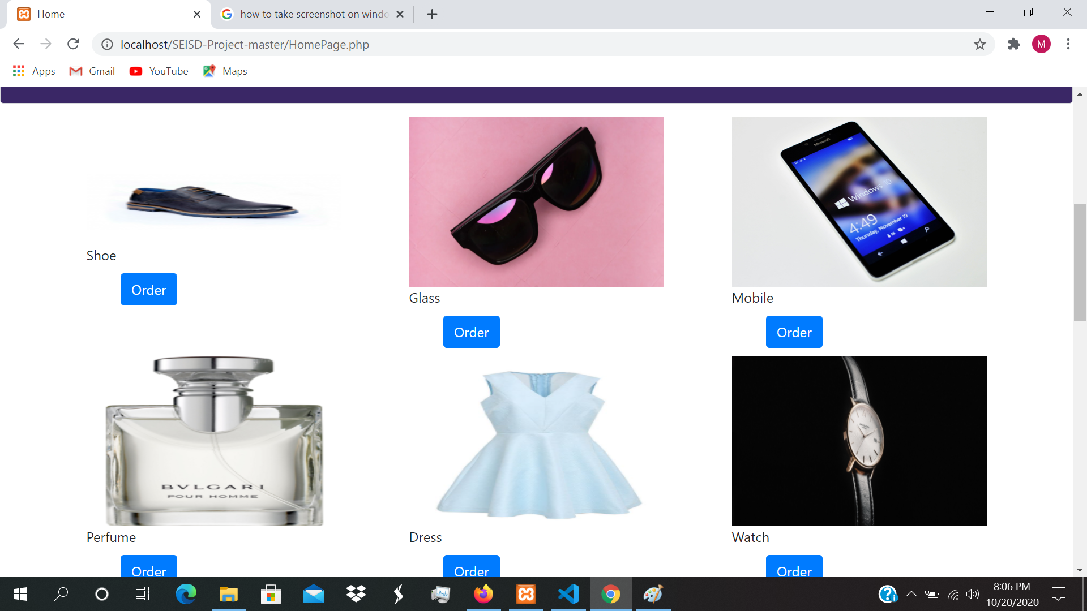
Homepage:

Slide 8
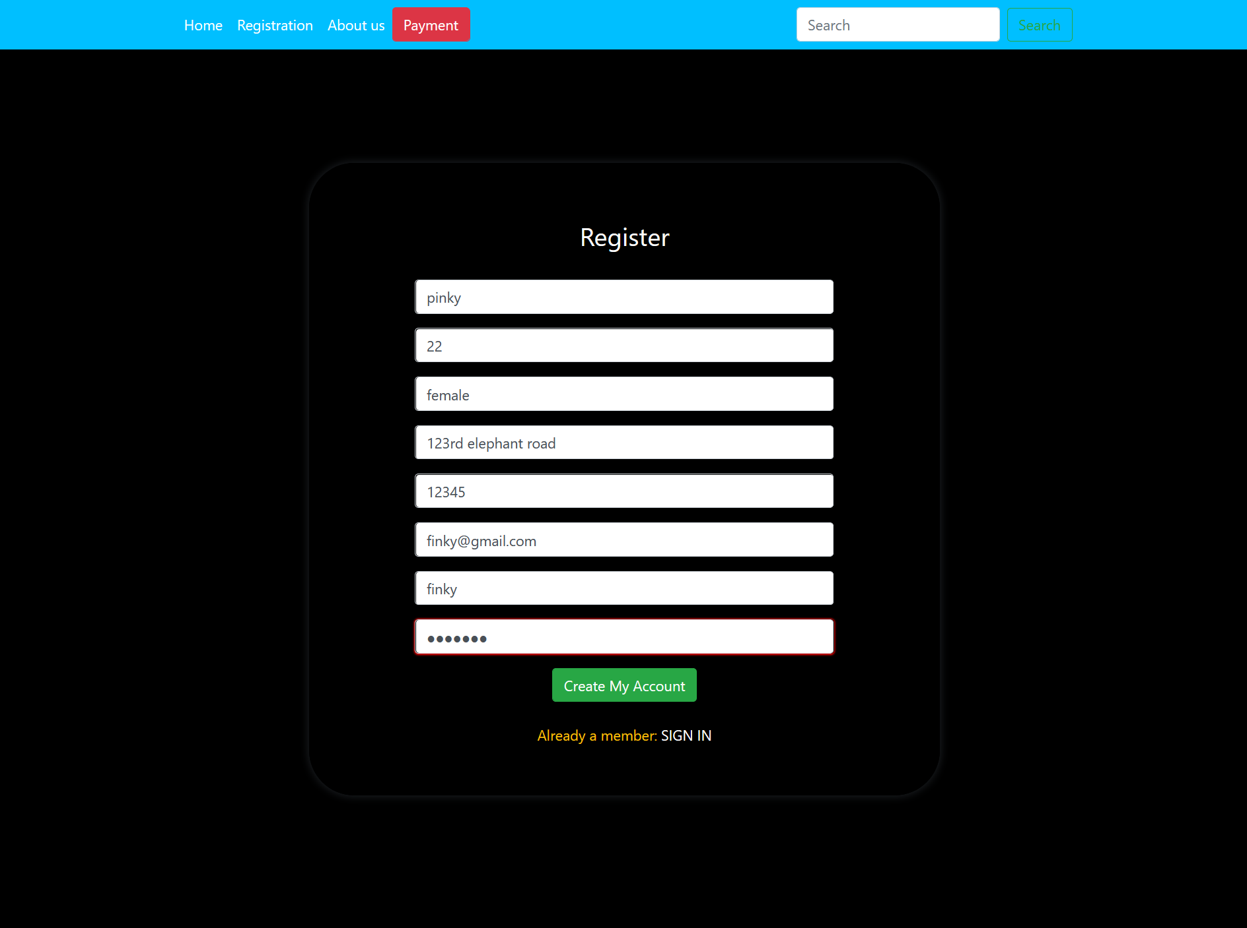
Registration

Slide 9
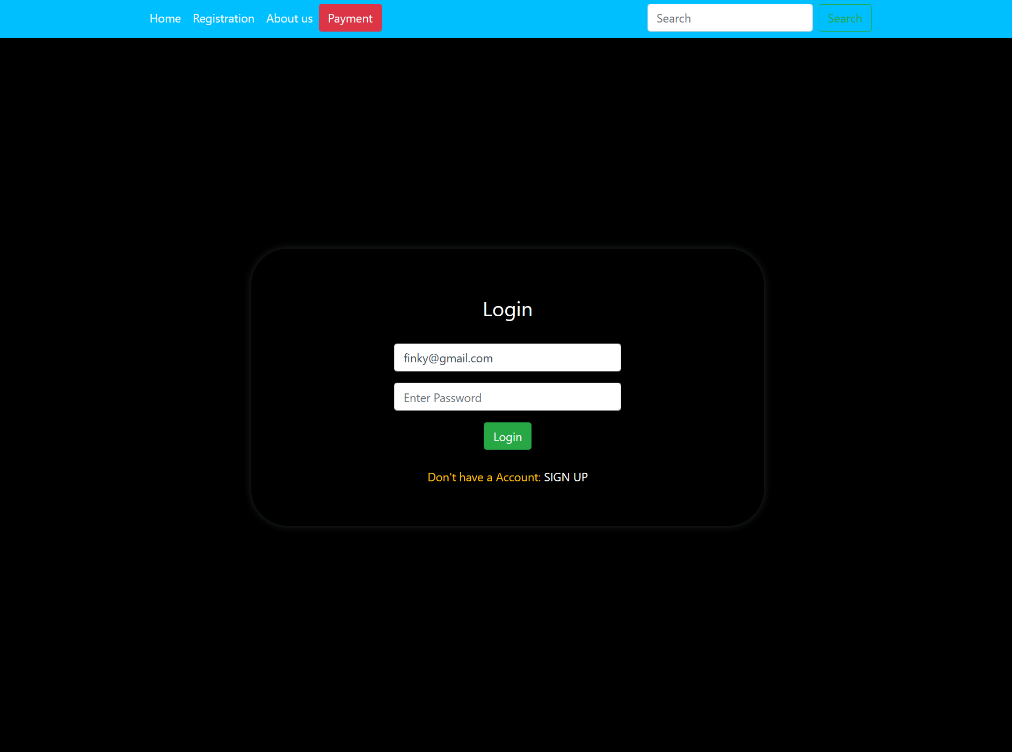
Log in:

Slide 10
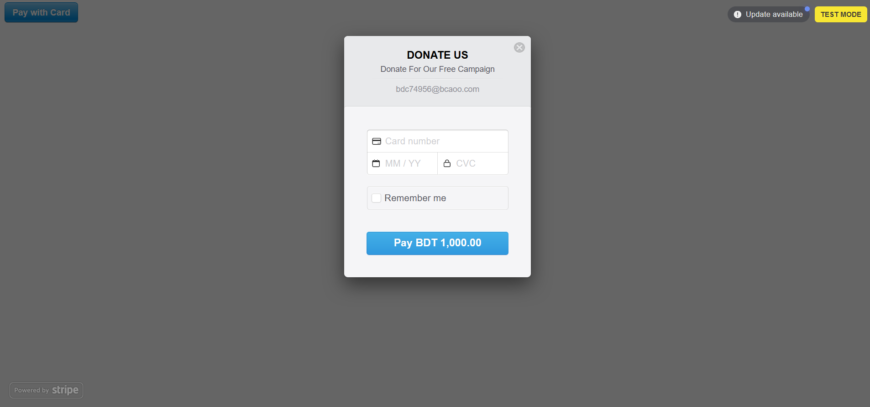
Payment:

Slide 11
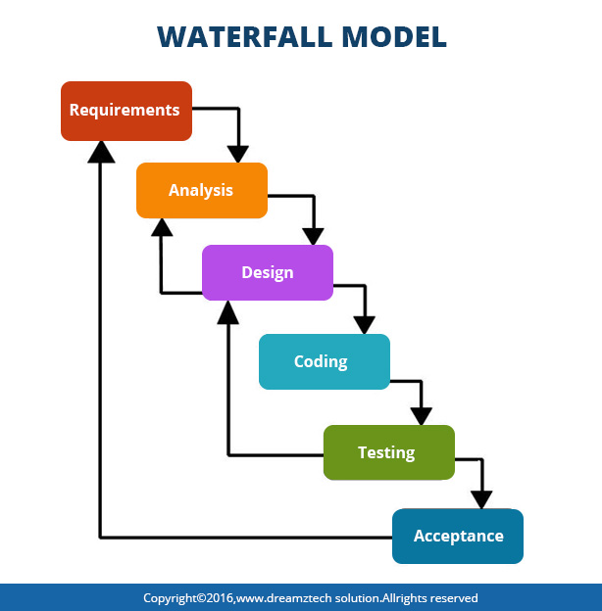
Methology:

Slide 12
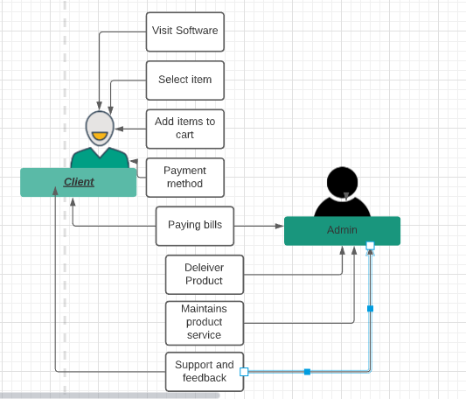
Methology:
Use case diagram:

Slide 13
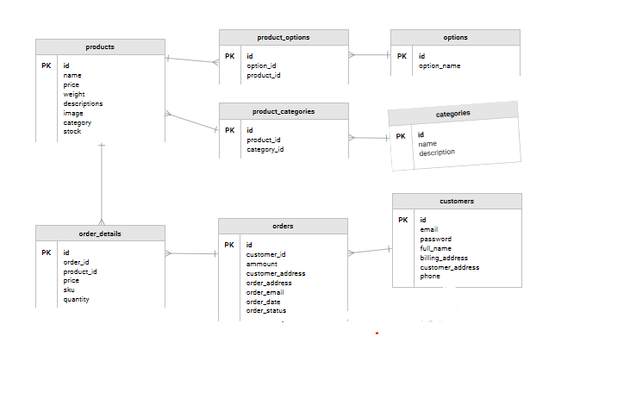
Methology:
ER diagram:

Slide 14
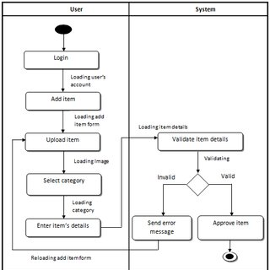
Methology:
Activity diagram:

Slide 15
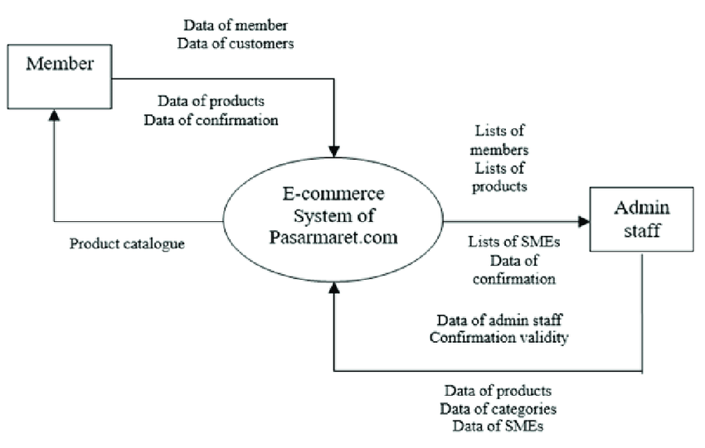
Methology:
Logical DFD:

Slide 16
Limitations:
Category work has not been done.
Adding product has not been done

Slide 17
Future work:
Our future plans for our project are:
Products will be added.
Products will catagorised.
The location of the customer will be tracked by app to deleiver product.
Within a short period products will be at the door of customers.
Our project will be used both nation and international wide.

Slide 18
Conclusion:
Our main purpose is to create a E-commerce site app that will be user friendly. We hope that our project will help admin to create a close relation with user. Our aim is also to communicate people who are willing to buy products and the people who are willing to sell products through online in few touches of software. It will less time consuming and user friendly too.The customer needs an account, send request to be member, add ordered products to cart and get deleivery within estimated time given by Admin.

Slide 19
Reference:
www.google.com
https://getbootstrap.com
https://w3schools.com
www.youtube.com
www.GitHub.com
https://lucid.app

Slide 20
The End

Slide 21


Slide 22

Any Question??

